Slide 1
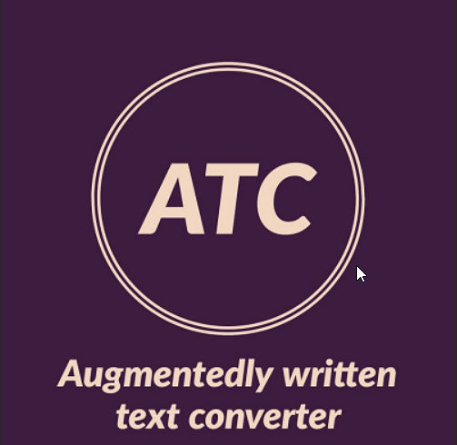

Slide 2
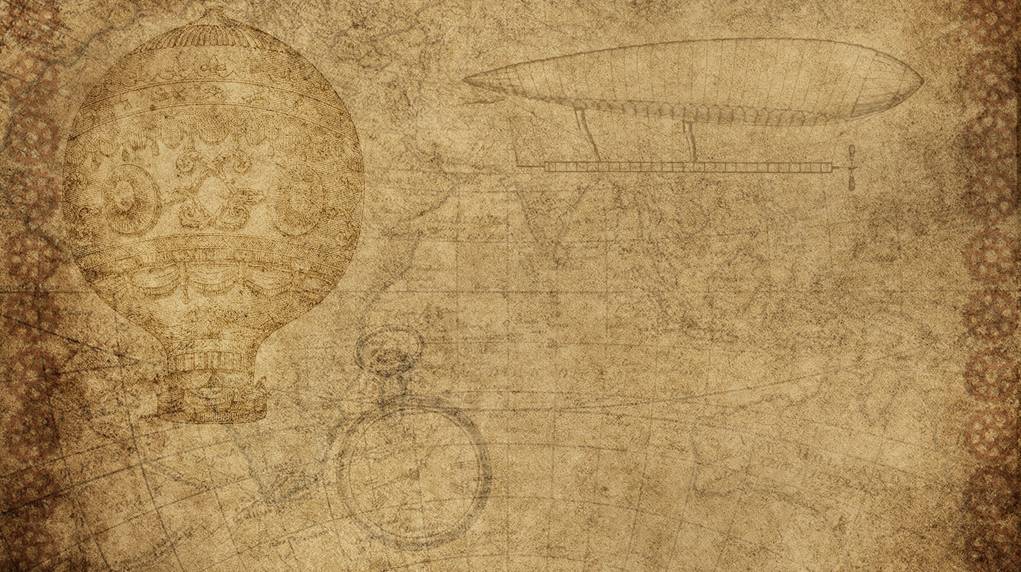

aUGMENTEDLY WRITTEN TEXT CONVERTER
By SRINITISH D-715521104046
DHANUSH KUMAR V-715521104010
SURIYA SAMPATHKUMAR -715521104048

Slide 3

aim
Augmentedly written text convertor is a python-based program using different modules. The aim of the program is to convert the virtually written data to be converted into text and to be stored so that we can use it to according to our need and to be able to modify it.

Slide 4

Who will use my invention
Who benefits from this invention? Why?
This invention is created for the benefit of teaching , business presentations, free time writings
This can be used at anytime with the help of color pointer by everyone from children to adults

Slide 5

Module used for invention
The module used for inventions are
Tkinter
Pil
Os
Pytesseract
Opencv

Slide 6
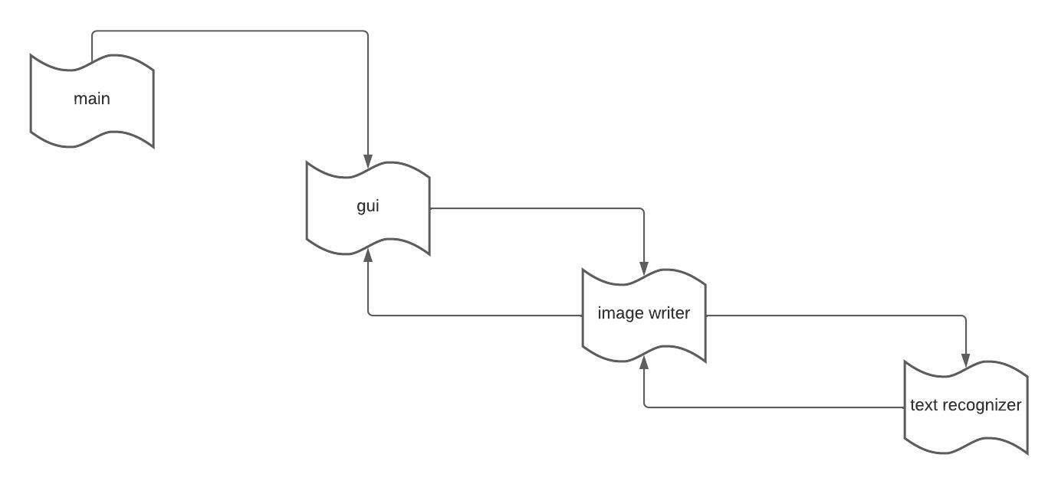
User defined modules

Slide 7
module uses
User defined modules
main.py
It is the start of the function where the program gets started. It has only one function (i.e.) to call the code_gui2.py module.

Slide 8
code_gui2.py
We use three different inbuilt modules Tkinter, PIL, OS. In this module we create two different frames to show the menu and select options to the user. This is the place where the user interface window is created. Here it is used to create the logo, background, user interface options like enter, exit. In the second page it has an entry box (where we browse the file location to save the image and text recognised), instructions, back button (which is used to return to the previous page), it also gives us three options like camera feed, plain image feed, and an option to check whether the colour you are using is being recognised.

Slide 9
code_writ.py
It is the module where your text is written augementedly. We use following packages CV2, time, os in this module. The input video is captured using open cv function. Each frame of the video is processed separately. This module enables the user to augmentedly write using the specified colour by detecting it in each frame. Whatever the user writes, are copied into a plain white image file, which is then used to recognise the text in the image.

Slide 10
code_vrecog.py
This module is used to recognize the text that is stores in the image from the previous module. Here we are using pytesseract library Which uses the tesseract optical character recognition engine. It gets the image and sends it to a function where the texts in the images gets recognised and it is stored in a text file where it can be modified and used later.

Slide 11
Installed packages:
Tkinter:
Tkinter is a default standard graphical user interface module in python. It provides various visual operations such as creating windows, frames, menu, labels, buttons, entry box as well as allowing to manipulate it. Through the tkinter module the user is able to view the options and is able to select the options like enter, exit, close, save, quit.

Slide 12
PIL:
PIL is an imaging library for Python. It is used for image processing where computational transformation of images occurs. This involves working on images as a 2-dimensional signal through its pixel composition. Here, we import ImageTk, Image which is used to display pictures in the Tkinter window by specifying the name of the picture.

Slide 13
Opencv:
OpenCV (Open Source Computer Vision) is an open-source library that includes several hundreds of computer vision algorithms.it is used for various purposes in this programme like image processing, video analysis, object detection, video i/o.

Slide 14
Time:
This module provides various time-related functions. It allows us to get the specific current time while the programme is running. It is an important part of the programme since it helps in the process of separating the characters of the text using computational process.

Slide 15
Os:
This module provides a portable way of using operating system dependent functionality. It is used to get the location of the python file to give a default saving location

Slide 16
Pytesseract:
Python-tesseract is an optical character recognition (OCR) tool for python. That is, it will recognize and “read” the text embedded in images. This uses the Tesseract OCR engine to recognize the text in the image

Slide 17
Sample output
Main page
Menu page

Slide 19
Camera feed

Slide 20
Thank you

